Slide 1
EE-2003 Computer Organization & Assembly Language
INSTRUCTOR
Engr. Aashir Mahboob
Lecturer, Department of Computer Science
FAST NUCES (Karachi)
aashir.mahboob@nu.edu.pk

Slide 2
JMP AND LOOP INSTRUCTIONS
By default, the CPU loads and executes programs sequentially.However, control may be transferred to a new location in the program.
A transfer of control, or branch, is a way of altering the order in which statements are executed, there are two basic types:
1. Unconditional Transfer: No condition is involved, control is transferred to a new location in all cases.
2. Conditional Transfer: The program branches if a certain condition is true (based on status of flags).

Slide 3

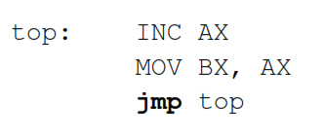
JMP Instruction
The JMP instruction causes an unconditional transfer to a destination, identified by a code label.
Offset of destination is moved into the instruction pointer, causing execution to continue at the new location.
L o g i c : E I P ← Label.

Slide 4

LOOP Instruction
The LOOP instruction, formally known as Loop According to ECX Counter, repeats a block of statements a specific number of times.
ECX is automatically used as a counter and is decremented each time the loop repeats.
L o g i c :
•ECX ←ECX –1
•i f ECX != 0 , jump to target

Slide 5
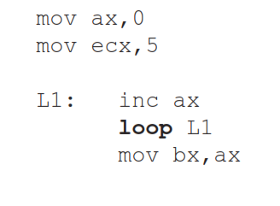
LOOP Instruction
The execution of the LOOP instruction involves two steps:
1. First, it subtracts 1 from ECX.
2. Next, it compares ECX to zero. If ECX is not equal to zero, a jump is taken to the label identified by destination. Otherwise, no jump takes place, and control passes to the instruction following the loop.

Slide 6
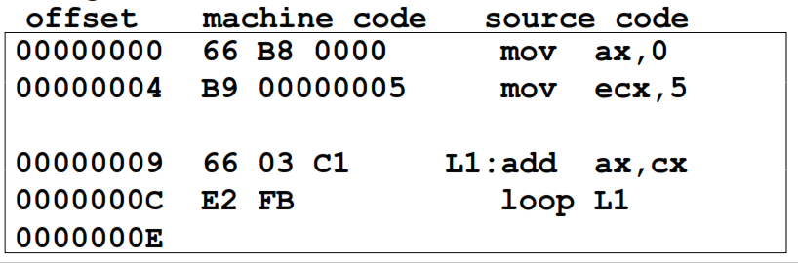
LOOP Instruction
•The assembler calculates the distance in bytes between the current location and the offset of the target label. It is called the relative offset.
The relative offset is added to EIP .

Slide 7
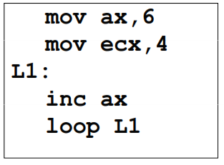
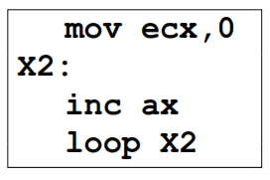
EXERCISE
What will be the final value of AX?
How many times will the loop execute?

Slide 8
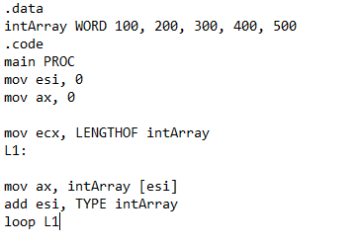
EXAMPLE
Final value of AX?
Final value of ESI?
No: of times loop executed?

Slide 9
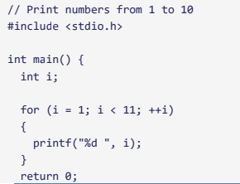
EXERCISE
Write a program to print the numbers from 1 till N(your desire higher range) and move value in eax instead of using print statement. The following is the helping program of numbers to print from 1 to 10.

Slide 10
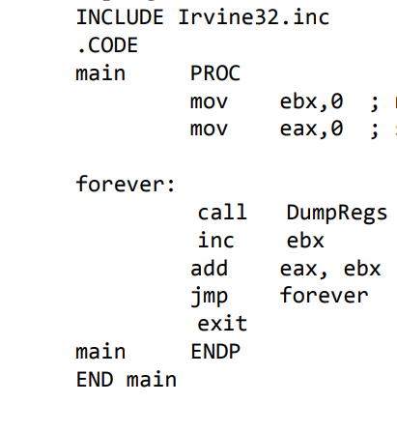
EXERCISE
Final value of EAX?
No: of times loop executed?

Slide 11
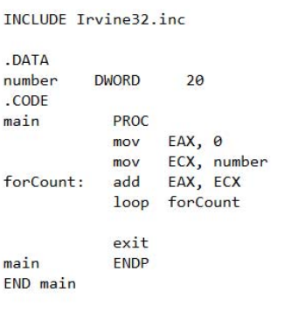
EXERCISE
Final value of EAX?
Final value of ECX?
No: of times loop executed?

Slide 12

Programming Errors with Loop
A common programming error is to inadvertently initialize ECX to zero before beginning a loop.
If this happens, the LOOP instruction decrements ECX to FFFFFFFFh, and the loop repeats 4,294,967,296 times! .If CX is the loop counter (in real-address mode), it repeats 65,536 times.
Occasionally, you might create a loop that is large enough to exceed the allowed relative jump range of the LOOP instruction. Following is an example of an error message generated by MASM because the target label of a LOOP instruction was too far away:

Slide 13
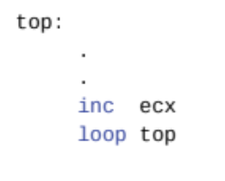
Programming Errors with Loop
Rarely should you explicitly modify ECX inside a loop. If you do, the LOOP instruction may not work as expected. In the following example, ECX is incremented within the loop. It never reaches zero, so the loop never stops:
If you need to modify ECX inside a loop, you can save it in a variable at the beginning of the loop and restore it just before the LOOP instruction:

Slide 14
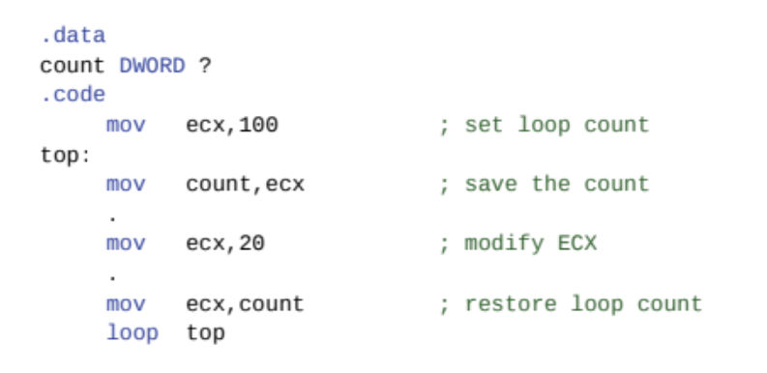
Programming Errors with Loop

Slide 15
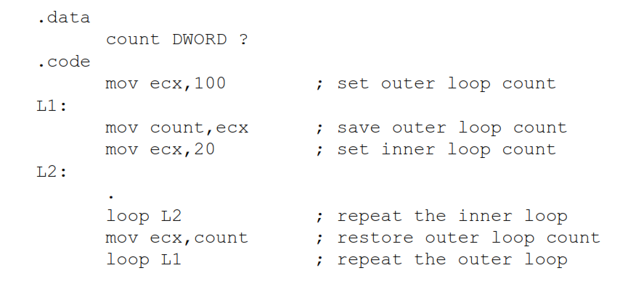
NESTED LOOPS
When creating a loop inside another loop, special consideration must be given to the outer loop counter in ECX. You can save it in a variable:

Slide 16
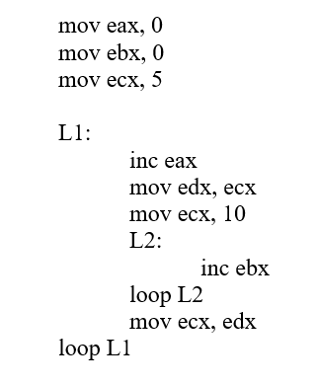
EXAMPLE
How many times L1 will execute?
How many times L2 will execute?

Slide 17
EXERCISE
Write a code to add 16- bit integers Stored in an Pre-defined Array.
LOOP Instructions must be Used.
Also use OFFSET, LENGTHOF and TYPE Operators.
Array must contain 4- unsigned intergers.

Slide 18
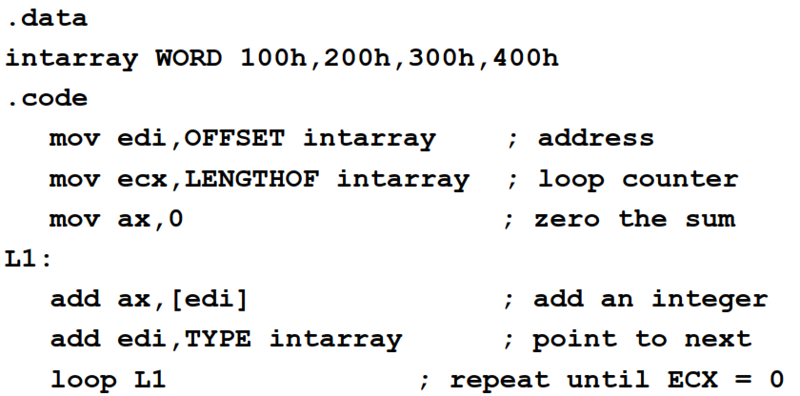
SOLUTION

Slide 19
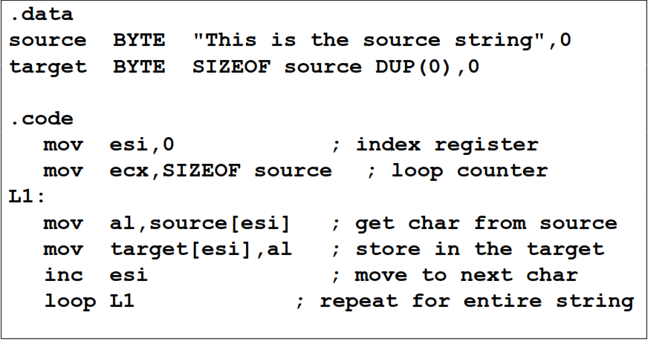
EXERCISE (Copying a String)

Slide 20
EXERCISE
Write a loop that iterates through a doubleword array and calculates the sum of its elements using a scale factor with indexed addressing.

Slide 21
EXERCISE
Write a program with a loop and indirect addressing that copies a string from source to target, reversing the character order in the process. Use the following variables:

Slide 22


